Slide 1
Lesson 10 Differentiation of Algebraic Functions Interactive Seminar
E114 – Mathematics for Engineering

Slide 2
Scenario
Suppose there is a competition.
In this competition, each team will be given a piece of cardboard as shown below:
50 cm
50 cm

Slide 3
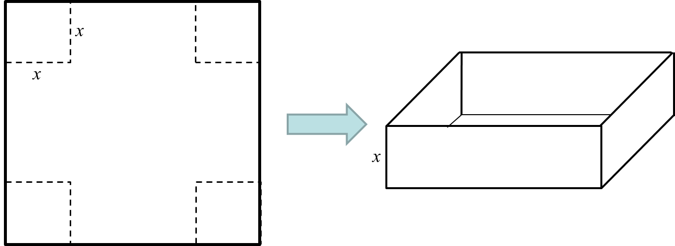
Scenario
The teams have to determine the value, x, for which 4 square corners of the cardboard have to be cut out to fold an open top tank as shown.
The winning team is the team that can identify the value of x which can produce an open top tank with the largest volume.

Slide 4
Scenario
Explore the 2 approaches to determine the:
(i) value of x, and
(ii) nature of turning point at point x (found in part i)
Differentiation of an algebraic function
Nature of turning point

Slide 5
Scenario Definition Template
What do we know?
How to calculate volume of a rectangular box given the dimensions
The x-dimension at the corners also represent the height of the box
What do we not know?
What do we need to find out?

Slide 6
Lesson Overview
S/N | Concepts | Slide Number
1 | Algebraic formulation of lesson trigger | 7-13
2 | Basic rule of differentiation | 14-17
3 | Optimisation: Finding max/min values | 19-21
4 | Using 2nd derivative test to determine nature of turning point | 22-27
5 | Applications of differentiation (CL) | 28-33

Slide 7
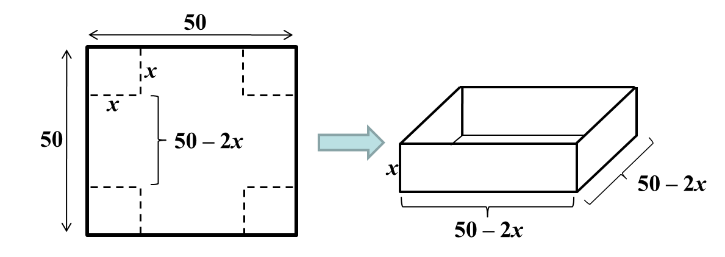
Volume of Box
It is often in our interest to generate the maximum benefits from a given amount of resources. In today’s problem, we want to make a box with the largest volume from a given amount of cardboard so that we can reduce wastage and be cost-efficient.
The volume, V, of the box is dependent on x. It can be expressed as:

Slide 8
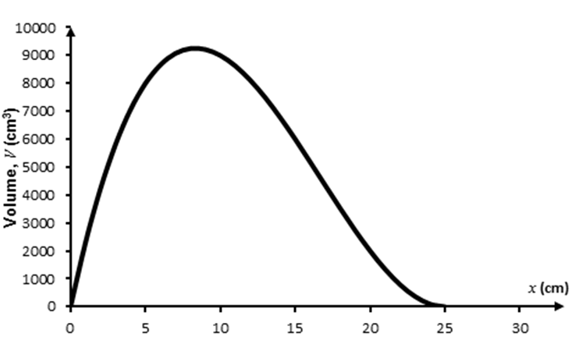
Graph
If we plot the graph of V against x using the equation
The graph shows that if x is too small or too large, the volume of the box will be small.
Also, there is a value of x near the middle which makes the volume of the box maximum.

Slide 9

Gradient of tangent
We can identify the value of x which makes the volume of the box maximum by observing how tangent to the curve changes.
The rate of change of volume w.r.t. x is obtained from the gradient of tangent at a particular point.
The gradient gets less steep as the tangent moves from left to right.

Slide 10
Gradient of tangent
Likewise, the gradient of the tangent gets less steep as the tangent moves from right to left.
The maximum value occurs at the point where the tangent is horizontal (i.e. the point where gradient of the tangent line is zero).
Gradient = 0

Slide 11
Gradient of tangent
In Summary, we have:
- Gradient > 0 at point on left side of the maximum point
- Gradient = 0 at maximum point
- Gradient < 0 at point on right side of the maximum point
Gradient = 0
Gradient > 0
Gradient < 0

Slide 12
Gradient of tangent
From A113, we have learnt that
The gradient of the tangent at a particular point, A, is the instantaneous rate of change at the same point, A.
The instantaneous rate of change at point A can be estimated by calculating the gradient of the line joining A and a nearby point, B, on the curve.
As B draws closer to A, the gradient of the line of AB will become the gradient of the tangent at A.
If h is small, i.e. Points A and B are very close, the gradient at A is 2x_{a}.
y
y = x ²
B (x_{a}+h, (x_{a}+h)²)
A (x_{a}, x_{a}²)
x
x_{a}
h

Slide 13
Gradient of tangent
So how to calculate the gradient of tangent of a curve y = x² at point A?
We estimate the gradient of tangent at A by finding the gradient of the line that connects A to a nearby point B .
As h tends to 0, i.e. B draws closer to A, the gradient at A becomes 2x_{a}.
This process is called Differentiation from First Principles.
y
y = x ²
B (x_{a}+h, (x_{a}+h)²)
A (x_{a}, x_{a}²)
x
x_{a}
h

Slide 14
Differentiation
Differentiation from First Principles is a tedious process.
Often we use this differential operator, , to find the general formula of the gradient of a function.
When the differential operator operates on a function f(x), it will produce another function f′ (x). The new function f′ (x) represents the gradient of f(x) at point x.
This process is called differentiation.
We are going to make use of differentiation to determine the gradient of the curve V and subsequently equate it to 0 to determine the value of x which makes V maximum.

Slide 15

Basic Rule of Differentiation
The most basic rule of differentiation on a function ax^{n}, where a and n are non-zero constant, is given as:
The differential operator has the following properties:
To differentiate, you bring
down the “power” value
and replace it with
“power” value -1
(k is a non-zero constant)

Slide 16
Worked Example – Basic rule of differentiation
Determine for the following function:
When we differentiate the function, we have:
[Solution]
Correct?

Slide 17

Test yourself – Basic rule of differentiation
Determine for the following functions:
a)
b)
c)
[Solution]

Slide 18
Basic Rule of Differentiation -Kahoot.IT
https://play.kahoot.it/#/k/504ae4c6-a87c-4651-acdb-40a7d26ea26f

Slide 19
Basic Rule of Differentiation -Kahoot.IT
Determine for the following functions:

Slide 20
BRAIN BREAK
“The secret of getting ahead is getting started. The secret of getting started is breaking your complex overwhelming tasks into small manageable tasks, and starting on the first one.”
- Mark Twain

Slide 21
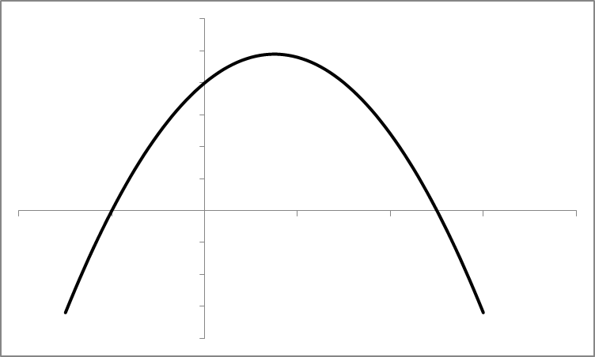
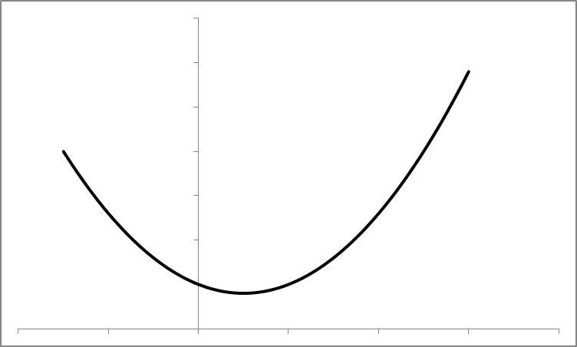
Optimisation: Finding max/min values
Recall that the gradient of a function at its maximum point is zero.
If a function has a minimum point, its gradient is also zero at its minimum point.
Gradient = 0
Gradient = 0

Slide 22
Optimisation: Finding max/min values
Recall that performing differentiation on a function produces the gradient or rate of change function.
Hence, when finding the maximum/minimum value(s) of a function , the steps taken are:
Step 1: Differentiate to give .
Step 2: Find the value(s) of x which satisfy .
Step 3: Substitute the value(s) of x found in step 2 into to find the max/min value(s) of the function.

Slide 23
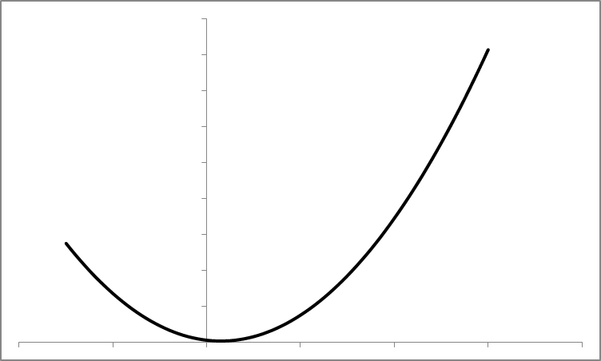
Worked Example – Finding max/min values
Find the minimum value of the following function:
Step 1: Perform differentiation to obtain .
Step 2: Set and solve for x.
Step 3: Substitute x = 0.3 into y .
Hence, the minimum value of y is 0.55, and it occurs when x = 0.3.
Note: This function has a minimum value as it is a quadratic function with positive coefficient of x².
[Solution]
Minimum point

Slide 24
Determine nature of turning point
One possible approach of finding the nature of a turning point of a given function is to evaluate the second derivative of the function.
Earlier when we perform differentiation on a given function, the resultant function is known as the first derivative of the given function. Performing differentiation on the first derivative would produce the second derivative of the given function.

Slide 25
Determine nature of turning point
To determine the nature of a turning point for a differentiable function f(x), the steps taken are:
Step 1: Differentiate to give .
Step 2: Find the value(s) of x which satisfy
Step 3: Differentiate to give .
Step 4: Substitute the value of x found in step 2
into
If the second derivative is positive, the turning point is a local minimum point.
If the second derivative is negative, the turning point is a local maximum point.

Slide 26
Worked Example – Determine nature of turning point
Find the nature of the turning point of the following function (taken from an earlier example):
Step 1:
Step 2:
Step 3:
Step 4: Since , the turning point is a minimum point.
[Solution]

Slide 27
Test yourself – Determine nature of turning point
a) Determine the turning point(s) for the following function
b) Determine the nature of the turning point(s) evaluated above.

Slide 28
Solution – Determine nature of turning point
a) Determine the turning point(s) for the following function:

Slide 29
Solution – Determine nature of turning point
b) Determine the nature of the turning point(s) evaluated above.

Slide 30
Applications of Differentiation (CL)
Quantity function
f (t)
Differentiate
Rate of change function
f '(t)
Displacement function
s(t)
Differentiate
Velocity function
v(t)
Velocity function
v(t)
Differentiate
Acceleration function
a(t)

Slide 31
Worked Example 1: Applications of differentiation (CL)
s(t) = 3t² + 5t + 2 describes a particle’s motion in meters. Find :
i) The velocity and acceleration functions
ii) The instantaneous velocity and acceleration at t = 5 sec.
i) v(t) = s’(t)
= 6t + 5
ii) At t = 5 sec,
v(5) = 6(5) + 5 = 35 m/s
a(5) = 6 m/s²
[Solution]
a(t) = v’(t)
= 6

Slide 32
Worked Example 2: Applications of differentiation (CL)
The electric charge entering a capacitor is related to time by the equation q = 3t².
Determine the current (i = ) after 5 seconds.
electric charge, q = 3t²
current, i = = 6t
At time (t) = 5 sec, i = 6(5)
= 30 amperes
[Solution]

Slide 33
Worked Example 3: Applications of differentiation (CL)
Find 2 positive numbers with the following criteria:
their sum is 9.
the product of one number and the square of the other number is a maximum.
Let x and y represent the 2 positive numbers.
The sum of the 2 positive numbers is:
x + y = 9
y = 9 – x
The product of one number and the square of the other number is :
P = xy²
= x(9 – x)²
[Solution]
Substituting for (y = 9 – x)

Slide 34
Worked Example 3: Applications of differentiation (CL)
[Solution]
Expanding the equation, we have:
P = x(9 – x)²
= x(81 + x² – 18x)
= 81x + x³ – 18x²
Differentiating this equation, we get:
P’ = 81 + 3x² – 36x
81 + 3x² – 36x = 0
27 + x² – 12x = 0
x² – 12x + 27 = 0

Slide 35
Worked Example 3: Applications of differentiation (CL)
[Solution]
x = 9 or x = 3
To determine the nature of the turning points:
Previously, P’ = 81 + 3x² – 36x
When x=9,
Thus, the turning point is a local minimum point when x=9.
When x=3,
Thus, the turning point is a local maximum point when x=3.

Slide 36
Worked Example 3: Applications of differentiation (CL)
[Solution]
From the equation : P = xy²
= x (9 – x)²
When x=3, P=108 (maximum value) and y = (9 – 3) = 6
Therefore, the 2 positive numbers are 3 and 6.

Slide 37
One-minute write
Instruction for lecturers: please copy the correct link and put it in the yellow box in the next slide for your IS class:
https://todaysmeet.com/LRE2-Day3
https://todaysmeet.com/LRE4-Day3
https://todaysmeet.com/LRW3-Day3
https://todaysmeet.com/LRW5-Day3
https://todaysmeet.com/LRE5-Day3
https://todaysmeet.com/LRE2-Day4
https://todaysmeet.com/LRE4-Day4
https://todaysmeet.com/LRW3-Day4
https://todaysmeet.com/LRW5-Day4
https://todaysmeet.com/LRE5-Day4
https://todaysmeet.com/LRE2-Day1
https://todaysmeet.com/LRE4-Day1
https://todaysmeet.com/LRW3-Day1
https://todaysmeet.com/LRW5-Day1
https://todaysmeet.com/LRE2-Day2
https://todaysmeet.com/LRE4-Day2
https://todaysmeet.com/LRW5-Day2
https://todaysmeet.com/LRW3-Day2

Slide 38
One-minute write
Instruction for lecturers: please copy the correct link and put it in the yellow box in the next slide for your IS class:
https://todaysmeet.com/LRE2-Day5
https://todaysmeet.com/LRE4-Day5
https://todaysmeet.com/LRW3-Day5
https://todaysmeet.com/LRW5-Day5

Slide 39
One-minute write
Please stop what you are doing and produce a written response to either of the following in only one minute:
What steps should you take to solve the problem in the trigger?
Link:

Slide 40
Learning Objectives
Perform differentiation to obtain the rate of change of an algebraic function.
Compute the turning point of a differentiable function.
Compute the second derivative to determine the nature of the turning point(s) of a function.
Model and solve real world problems involving differentiation of algebraic functions (e.g. determine the maximum/minimum values of a function with at least one parameter being a variable).

